Slide 1
Module 2
System Architecture & Agents Planning
Notes:
Exploring how AI agents revolutionize stock analysis

Slide 2
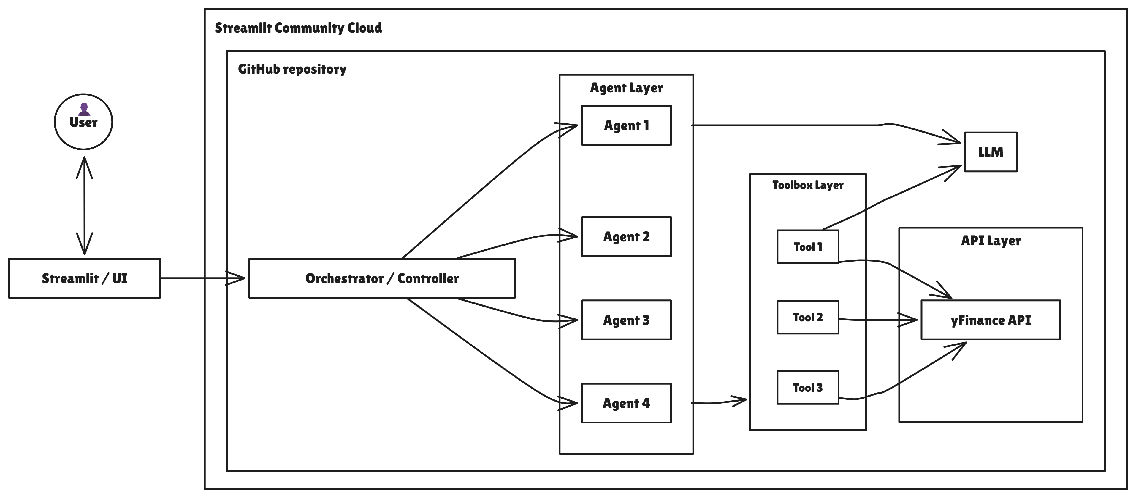
End-to-End Architecture Overview

Slide 3
Flow of the information
LLM + Orchestrator: LLM or controller initiates/coordinates actions.
Agents: Modular units for specific roles (data fetch, analysis, summary, strategy).
Tools: Invoked by agents, wrapping financial logic.
API (yFinance): External source of financial data.
UI: User interacts via Python-built frontend (Streamlit/React).
Cloud Deployment: Final product is deployed on a cloud platform.

